Slide 1
What does DIGITAL IMAGING mean to our pupils?
Monthly report of project FAST, Primary School Blanca
School project coordinator: Roman Drstvenšek
November 2017

Slide 2
2nd grade, Mrs. Ksenija Juh, prof.
My project made with 6-year-old pupils
We were using the Pixlr.com program, within learning about prepositions (Mother tongue).
Before practical exercise, I asked them several questions:
Do you know, what a computer is?
Answers: Yes. Of course.
What do we do with a computer?
Answers: I use it for watching cartoons, youtube. I play computer games.
What do you think, digital imaging is?
Answers: Animal footprint. Human footprint. Finger trace. Photography.

Slide 3
Aspects in relation to Pixlr: (my opinion, as I look at the program)
Can we, as educators, start using the program without being experts in advance?
Of course, I think, the will is important, and to overcome fear of the unknown. I did not have any problem to start and explore.
How can we use our students as fellow teachers?
My 6 year old pupils (who already have some experience) helped me to teach weaker pupils (they were exposed to the computer program for the first time, computer games are excluded).

Slide 4
How can we in an educational situation use Pixlr at different levels in relation to Bloom's Digital Taxonomy?
At this point in my classroom we recall facts and basic concepts. Pupils define, repeat, memorize new data.
I have been working on the first level of Bloom's digital Taxonomy, using lower thinking skills.
What worked well with Pixlr and what did not work?
At this point, there were no problems.

Slide 5
5th grade, Mrs. Majda Stopar, prof.
In November I introduced ten-year-old pupils to the Pixlr computer program.
I myself did not know the computer program, so this was a new experience for me. I was looking for ideas how to use it in my teaching process. At the beginning I decided to use it in my art lesson. Since children know the program Painter, I was hoping that the work would be easier.
Since several teachers at school participate in the project and have already completed the task, I got an idea why not use the knowledge of pupils of higher grades who have already worked with the program. So one student of the 9th grade came to the lesson and we presented the program frontally beginning with simple tool icons. In the case of a photo, we tested and reproduced it. I suggested that pupils try their own program at home.

Slide 6
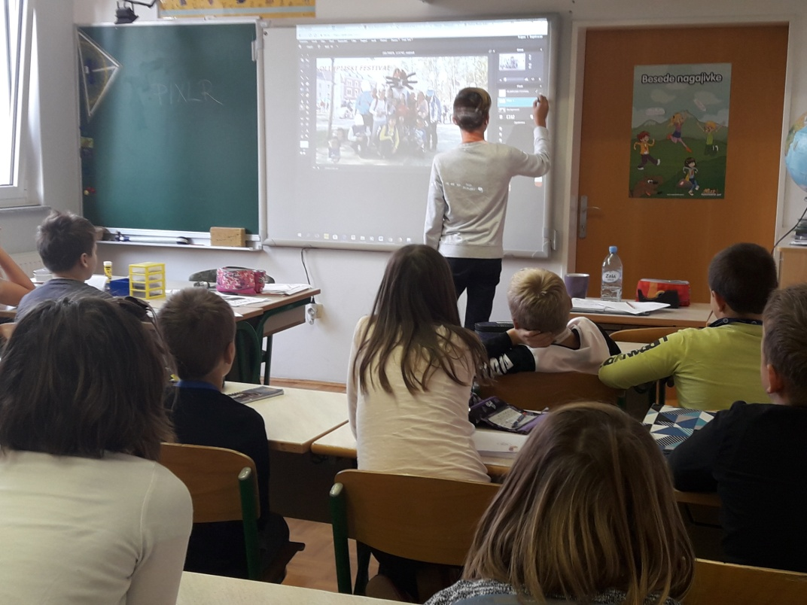
At our next art lesson, students, with my guide, found a picture of the map of Slovenia on the internet and pasted it into the program. They transformed it using their imagination. They added inscriptions, cut out pieces, painted it and similar. Three 9th grade students helped the children and supported them. . It was interesting to observe how quickly the pupils conquered new commands and shared their knowledge among themselves. As soon as someone did something new, s/he showed it to others causing the chain reaction to begin.

Slide 7
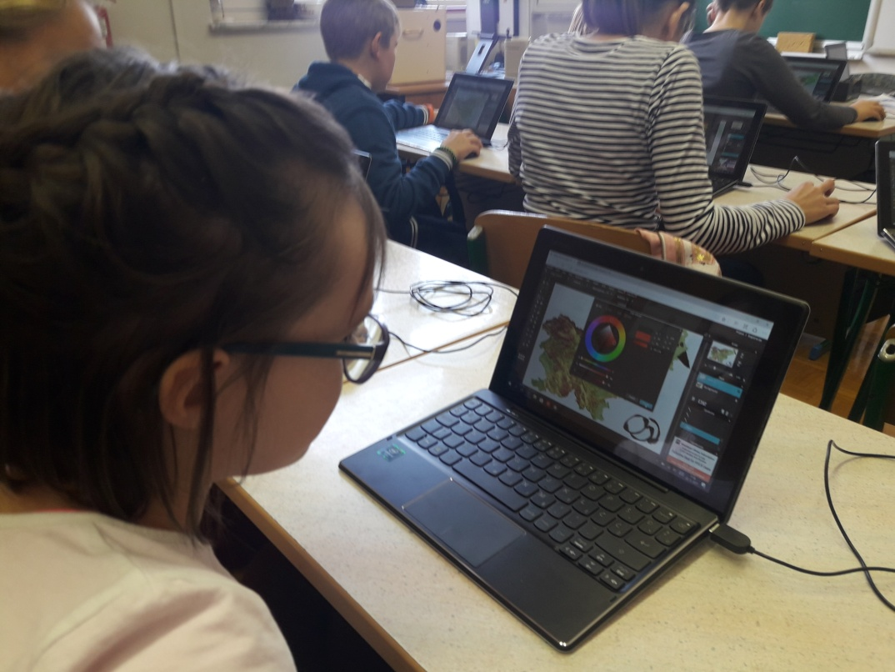

Slide 8
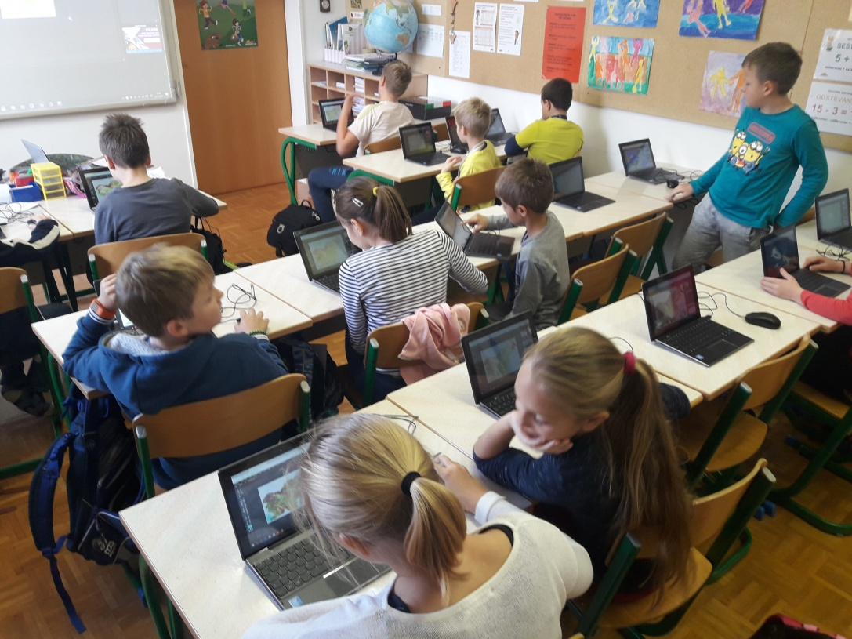
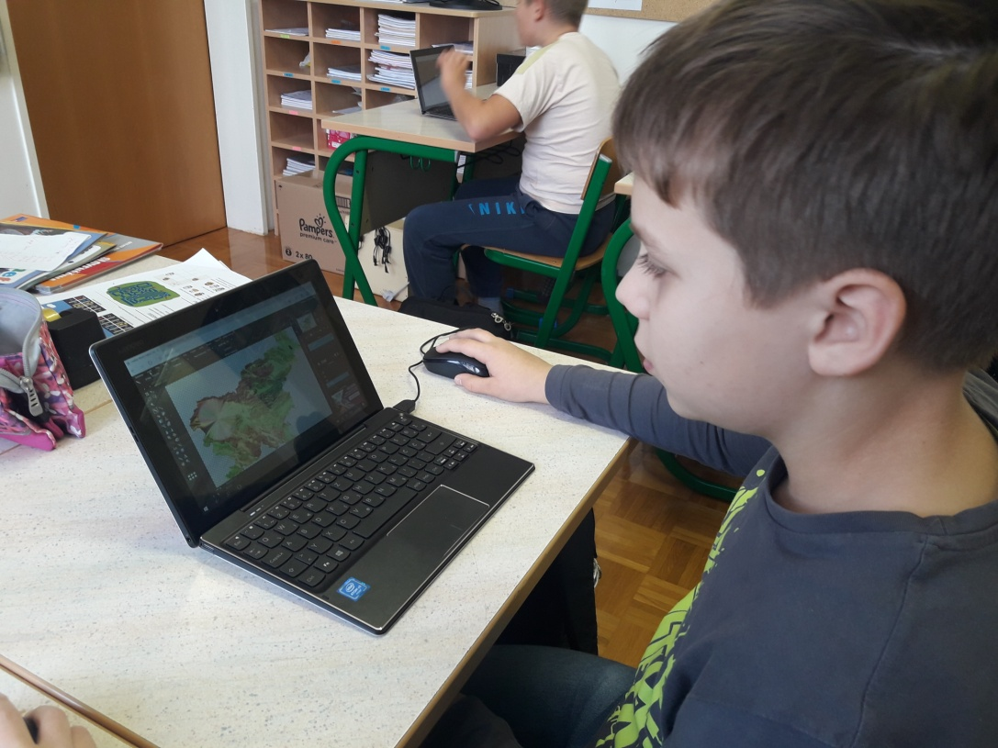
I have found out that the Pixlr program can also be used at various stages of the BDT. As I see and understand the taxonomy, firstly icons were recognized and later they were correctly used after understanding the functions of the tools. In submitting new findings, they were analyzed and synthesized.

Slide 9
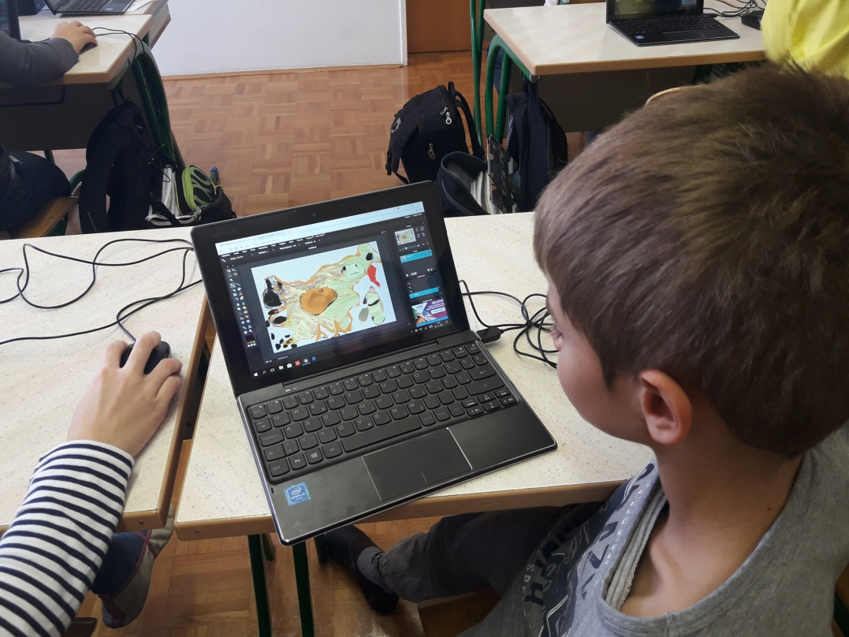
I was happy and I believe the purpose was achieved, as the children told me the following days what they were creating at home. Older students showed them an interesting transformation of photographs. They were most impressed by them. Surely this will be our next task.

Slide 10
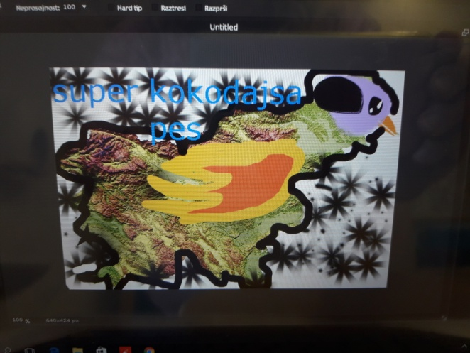
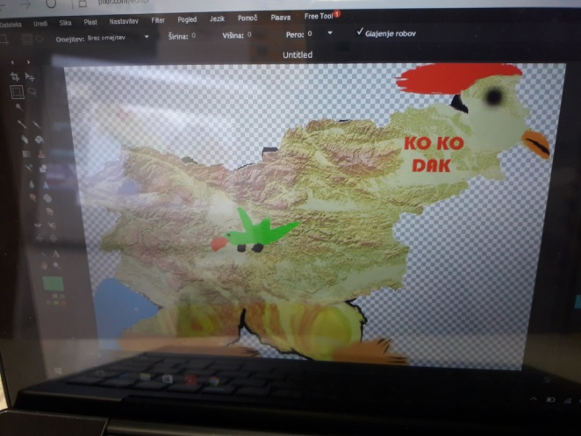
Pupils do not know the concept of a digital footprint. Their answers were derived primarily from the word imprint. The concept of digital is foreign to them, that is why I started explaining from a concrete example - digital camera, digital photography. Thus, we came up with an answer in a simplified and easier way. Editing digital content is a less-known area for children. Surely, they have advanced with new experiences and will continue further on.

Slide 11
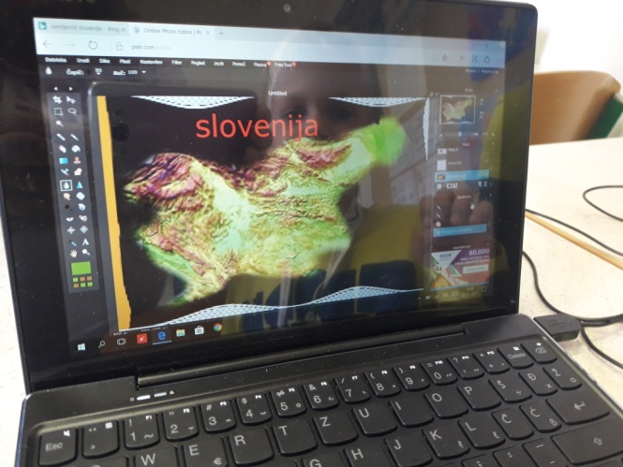
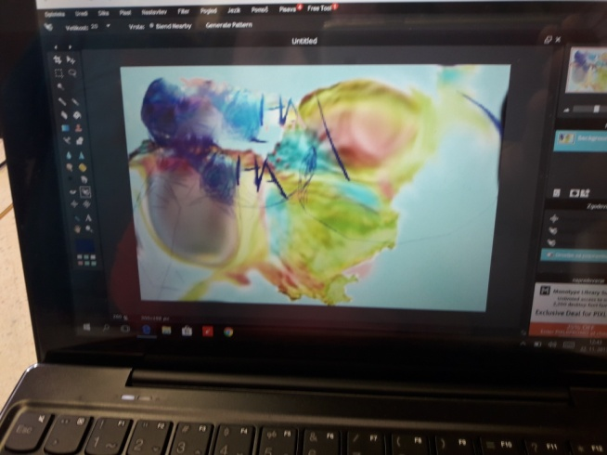
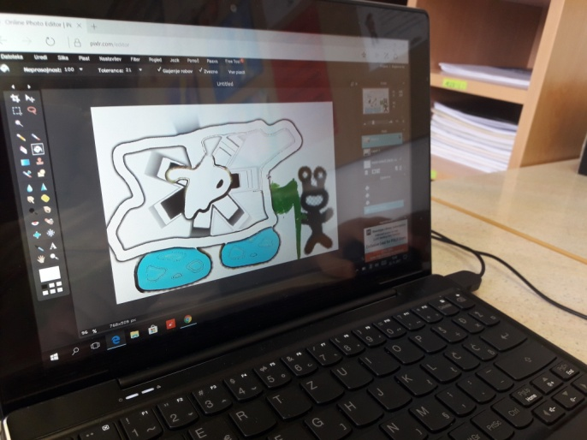

Slide 12
Foreign language teacher Mojca Hojski, prof.
After asking pupils aged 12 to 14 most of their responses included the following explanation:
IMAGING: pictures, selfies, paintings
DIGITAL: everything connected to technology such as computers, tablets, phones
So digital imagining to most of them means that you upload pictures from your devices on the computer and you shape or design them with different programs like Photoshop or Pixlr or simply post them on various social media such as Facebook, Snapchat , Google+ etc.

Slide 13
Mojca Hojski: My personal experience
I have proven that the teacher does not need to be an expert to apply new technology into the classroom. The teachers of today need to be aware that their pupils spend a lot of time on the Internet, using different social media, apps and programs that we as teacher do not necessary know or are familiar with. I did not know the program Pixl before, but as one of my colleagues enabled our pupils to do some research on their own, I too became intrigued. The next day I saw one of my pupils programing on our school tablet in his free time so I walked to him and told him how far I came and we exchanged views as well as our feelings about this program.

Slide 14
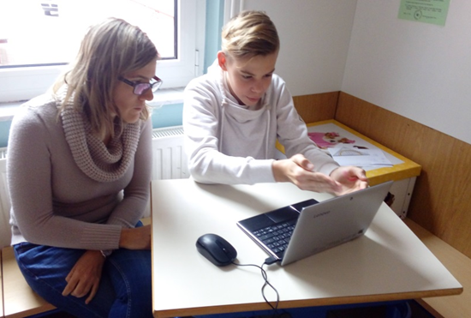
The funny thing happened that the boy uses Photoshop a lot and as I am an English teacher, we are both more familiar with the English terminology rather than the Slovene one, so we changed the language back to English and found more tools and easier access to what we wanted to do in the program like insert new layers, duplicate them etc. He showed me what he had already done, I gave him some more ideas and similar. So we combined many things in that half an hour: we had a pupil-teacher session, practiced English, explored new possibilities within the program and exchanged views. We both benefited from the exchange and gathered new ideas for future work.

Slide 16
Fine art teacher Sabina Košir, prof.
When I was acquainted with the project, I decided to learn the Pixlr Editor program. It can be used it to perform certain artistic tasks in the class of fine arts in the 9th class of primary school. I didn’t have previous knowledge of the selected application, but I've mastered similar programs, so the transition to Pixlr Editor wasn’t difficult. I chose the field of spatial design for the first art task. I didn’t know the preliminary computer literacy of students, because I only met them this year. That's why my first question was, if any of them might already know the Pixlr Editor program/application. Most of the students answered negatively. Some students told me that their class teacher suggested that they study the program at home, and they said that they just took a “quick look” at the program. Four students stated that they are already working with similar programs, and that there will be no problems, while the rest of them have not yet dealt with such programs. Pupils also said that they use simple applications to process photos at home, on their smartphones, with which they easily add different effects to their photos.

Slide 17
The task in November was that we get acquainted with certain concepts related to the project and to find out what our students know about them. Since I didn’t want to influence students’ opinions, I distributed a questionnaire for them to fill out. I asked them to write what they think is the term Digital Imaging. Since we will be working with photos and also making a short animation in the next few hours, I asked them to evaluate their previous knowledge in editing digital photos (grade 1-10).
On the basis of the received responses, I found that the concept of Digital Imaging is perceived as a picture made using technology (camera) that is loaded onto a computer, where it can also be manipulated.
The teaching of fine arts is carried out in the 9th grade of elementary school once a week for 2 school hours and lasts half of the school year. Due to time constraints, I wanted students to acquaint themselves with the chosen application as quickly as possible and prepare them for more demanding tasks related to the visual media that will follow in the coming weeks.

Slide 18
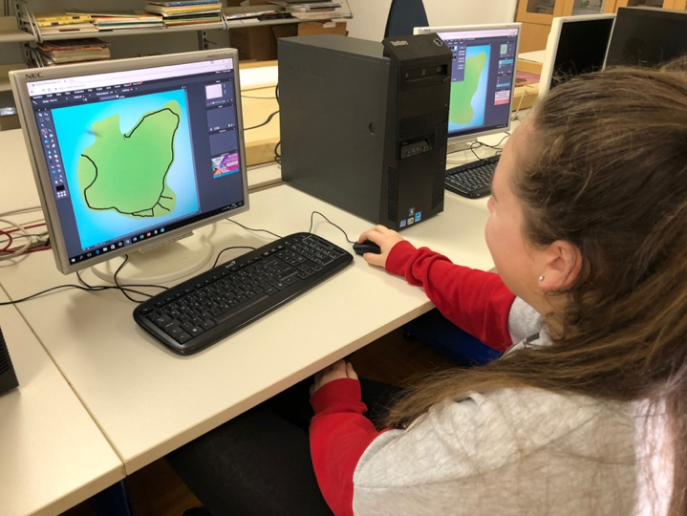
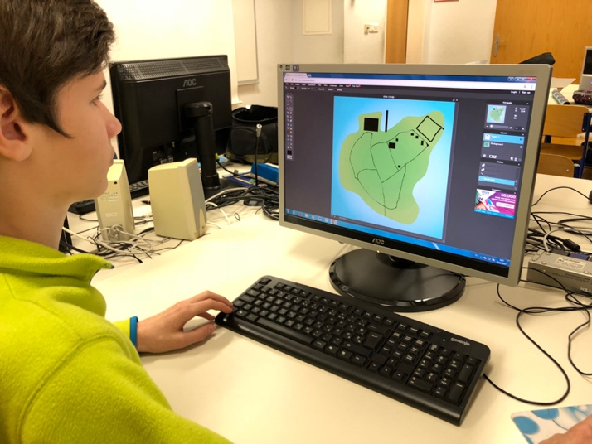
Our first task, which was carried out in the Pixlr Editor program, was related to urban space.
At the beginning of the first hour we discovered what urban space is, how they picture it, what it includes, and who plans it. In the second part, practical work followed. The pupils had to take on the role of urban planners and make sense of the infrastructure on their "island". Since only 2 school hours were available for the entire task, I drew out the island background, which served as a basis or starting point for further work.

Slide 19
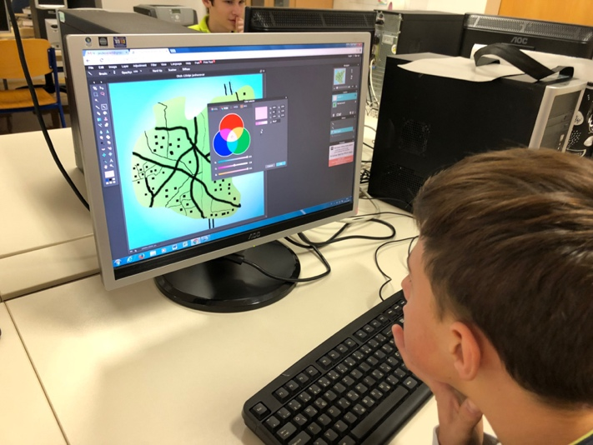
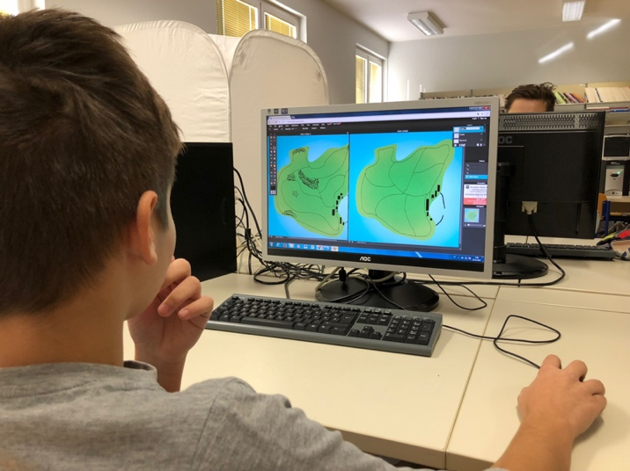
We started with the basics, opened the program, inserted the image as a background picture and I explained the basic tools and layers of the Pixlr Editor application. Because the pupils were very perceptive, I let them continue on their own. During their work they were exploring the possibilities of the program. When they encountered a problem or some of them asked the question, I showed everyone a solution through a projection.
The products were produced at different speeds. And immediately, there were differences between those who had previously worked in similar environments and those who were new to this kind of work.

Slide 20
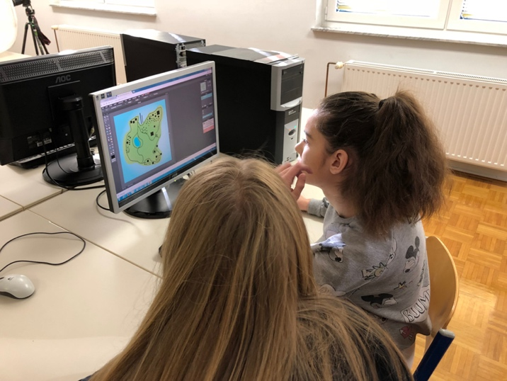
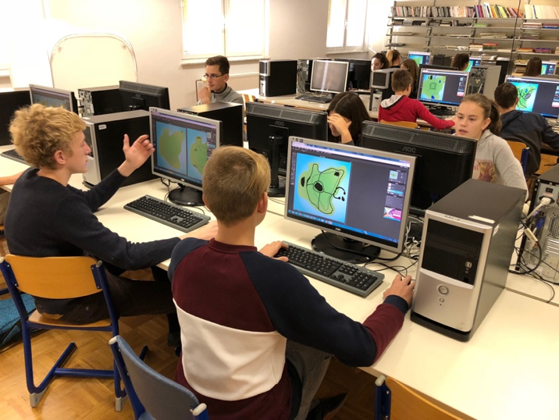
Most problems were related to drawing, because the mouse is not an easy tool to use hands-free drawing on a computer.
There were many questions; most were related to the use of various tools and their settings or properties (Move tool, Marquee tool, Brush, Eraser, Paint bucket, Hand tool, Zoom, ...). Together we succeeded in understanding the basic function of the layers and the free transform tool. I liked the cooperation between pupils, because they were learning from each other and everyone discovered something new. We learned the most through random errors, clicks that students didn’t intend to do, but they just "happened". The pupils mistakenly clicked on another tool and something new was created. They found out that saving your progress is also very important, otherwise you will lose everything with just one wrong click. And this revealed the application’s weakness, as it has "frozen" several times.

Slide 21
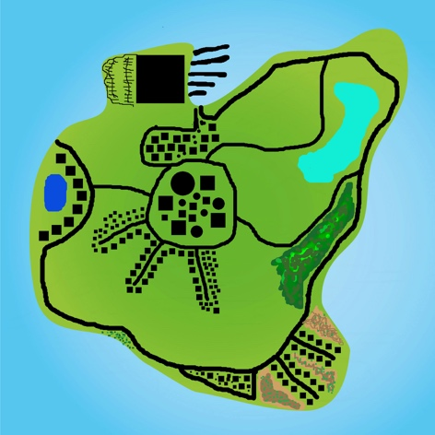
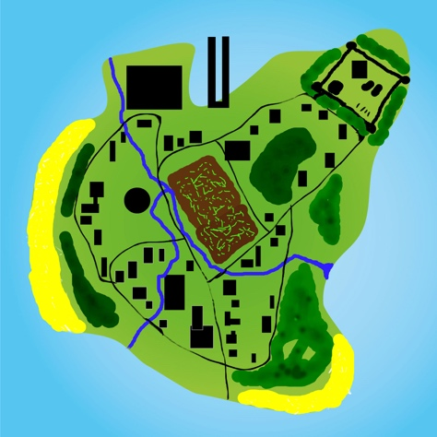
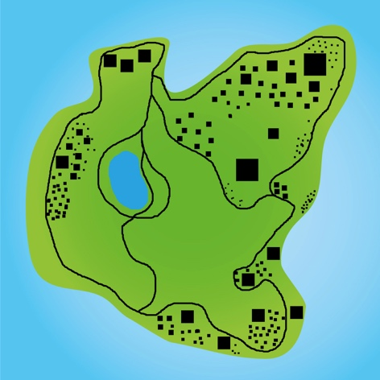
I ordered pupils to save their products in two formats, JPEG and PXD files. I explained to them the difference and the importance of preserving the original format with which they can continue their work at home.
The products of the pupils are fully presented in the enclosed presentation.

Slide 22
Can teachers use programs we are not experts on?
My answer is: definitely. I also deal with graphic design and in my work I use both professional and open source programs. In the past years, I also taught or coached the programs and, considering the different age groups of participants, I know that anyone can learn and master something new in a very short time, if they have the will to do so.

Slide 23
How can Pixlr Editor be used at different levels according to Bloom's Digital Taxonomy?
When performing the selected art work, I decided to concentrate primarily on the first, second and third levels of Bloom's taxonomy during the first two school hours. We learned the basics of the new Pixlr Editor program with pupils. They learned about new concepts, tools and rules of the program, which they later used in practical work. All pupils successfully completed the task. Based on their work and finished products, I found that pupils also successfully achieved the level of analysis, evaluation and creativity. I must note that these were the basics of creativity, since the task itself was designed in such a way that the pupils devoted themselves primarily to learning, understanding and using the new tool.

Slide 24
Can students also be used as teachers for certain programs (mutual assistance)?
Certain students can easily take on the role of a teacher or their assistant. Some students learn computer programs very quickly and can make it easier for others to get to know the new program. I think that students are excellent assistants. Especially in the beginning when there is a lot of individual work besides group explanation – two heads are better than one.

Slide 25
What is the Pixlr Editor program good for, what are its shortcomings?
The program is intended primarily for photo processing and retouching. It allows color corrections, removing elements, retouching, using masks, working with layers. It is very flexible and can be used with some imagination in most subjects in schools. However, there are problems with the online application, as it often "freezes" and stops working. Depending on the possibilities it offers, it can be an excellent didactic tool. I can only see one problem at the moment – that we do not have enough time to get to know programs, and that's why we can not always perform the tasks completely, as teachers are also learning about the abilities of students.

Slide 26
Pupils answer the question: What is digital imprint/ digital image?
Their answers:
A picture made and transformed by the help of technology.
Digital picture in a picture we upload from the camera or mobile phone on the computer.
It's a picture on the computer.
A picture made with a computer, a camera…
A picture made on the computer or not made by hands.
It's a picture put on the computer and edited there.
A picture we shape as we want and it's made with a digital device.
A picture we shape.
A digital picture or a digital picture is a picture uploaded from a camcorder or a camera on the computer.
It's a imaginary picture (you can't hold it).
A picture on the screen, on the computer.

Slide 27
Assess your knowledge of editing digital photography from 1 to 10 (the best).
From 1 to 10 | 1 | 2 | 3 | 4 | 5 | 6 | 7 | 8 | 9 | 10
Number of pupils. | 1 |  |  | 1 | 5 | 1 |  | 1 | 2

